Slide 1
Persistent Array
Kanko Ghosh
B-CSE II

Slide 2
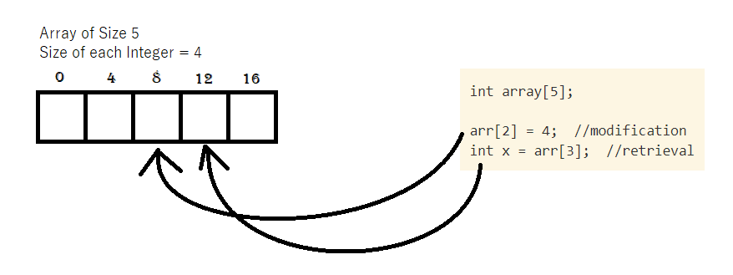
Ephimeral Array
Collection of items of same type stored in contiguous memory location
An element from a particular position can be retrieved or modified directly by calculating address of a location
Eg.
Required address of a position in an array = starting address+ (required index * size of data type)

Slide 3
Operations on array
modifyArray(a, i, e): store the value present in e, in the i-th element of array a
retrieveArray(a, i) : return the value of the i-th element of array a

Slide 4
Persistent Data Structure
Persistency can be achieved in a data structure, when we can preserve the previous version of itself even after modifying the data structure
Persistency can be partial: older versions can be retrieved but cannot be modified; and fully persistent: older versions can be modified as well as read by the user
Array can also be made persistent by few techniques

Slide 5
Copy on write method
Method 1

Slide 6
Copy on Write method
On updating an array, a new array is created (allocating memory followed by copying the data) and the corresponding update is made in the new array
Operations:
modifyArray(a, v, i, e): store the value present in e, in the i-th element of array a of version v
retrieveArray(a, v, i) : return the value of the i-th element of array a of version v

Slide 7
Copy on Write method
Fully Persistent and easy to implement
Worst case time complexity:
Storing: O(n), n is number of elements in array.
Retrieval: O(1), when the different array versions are stored in an array (using array of pointers)
Space Requirement: O(n*v), n is number of elements in array, v is number of versions (LIMITATION!)

Slide 8
Limitation and Solution
Limitation: Same elements stored multiple times
Solution: only the element which is changed, is stored in the array

Slide 9
Fat Node Method
Method 1

Slide 10
Fat Node Method
Target: Only the particular value of an element in an array is stored in the array, when it is changed.
Approach: Each element in the persistent array will point to a linked list, which is storing the modified values at a particular position of an array, along with the versions in linear fashion
Retrieval: on requesting the value of a particular version at a particular position, the linked list pointed to by the element of the array is traversed.

Slide 11
Comparison in Fat Node Method
Partial Persistent
Fully Persistent
Modifying: version history is not required
Since the older versions cant be modified, no version history is required
On requesting a version, a value is chosen whose version is just less than or equal to the requested version
Modifying : version history is required to keep record of ancestors
Version history (stored in tree/trie/array) is required to check the ancestor of a requested version
On requesting a version, the version just less than the requested version, may not be the ancestor of requested version, so the version history must be checked.

Slide 12
Fully persistent array
Implementation

Slide 13
Implementation
Data Structure: Array of pointers, version history (in form of tree/array)
Operations:
ModifyArray(A, V, P, N) = store value N at position P of version V of array A
Retrieve(A, V, P) = return value at position P of version V of array A
Clear(A) = remove all the previous versions of array A

Slide 14
Simulation
Query: Init(version = 0, arr{1,2,3,4}, size = 4}
Version Track
(for simulation purpose)
Val = 1, Ver = 1
Val = 2, Ver = 1
Val = 3, Ver = 1
Val = 4, Ver = 1
1 2 3 4
0 1 2 3 4 5 6 7 8 9 10
Version History
0

Slide 15
Simulation
Query: ModifyArray(version = 1, position = 1, value = 10)
Version Track
(for simulation purpose)
Val = 1, Ver = 1
Val =10, Ver =2
Val = 3, Ver = 1
Val = 4, Ver = 1
1 2 3 4
1 10 3 4
Val = 2, Ver = 1
Version 2 created,
from version 1
0 1 2 3 4 5 6 7 8 9 10
Version History
0
1

Slide 16
Simulation
Query: ModifyArray(version = 1, position = 2, value = 10)
Version Track
(for simulation purpose)
Val = 1, Ver = 1
Val =10, Ver =2
Val =10, Ver =3
Val = 4, Ver = 1
1 2 3 4
1 10 3 4
1 2 10 4
Val = 2, Ver = 1
Val = 3, Ver = 1
Version 3 created,
from version 1
0 1 2 3 4 5 6 7 8 9 10
Version History
0
1
1

Slide 17
Simulation
Query: ModifyArray(version = 2, position = 0, value = 5)
Version Track
(for simulation purpose)
Val = 5, Ver = 4
Val =10, Ver =2
Val =10, Ver =3
Val = 4, Ver = 1
1 2 3 4
1 10 3 4
1 2 10 4
Val = 1, Ver = 1
Val = 2, Ver = 1
Val = 3, Ver = 1
5 10 3 4
Version 4 created,
from version 2
0 1 2 3 4 5 6 7 8 9 10
Version History
0
1
1
2

Slide 18
Simulation
Query: ModifyArray(version = 3, position = 1, value = 10)
Version Track
(for simulation purpose)
Val = 5, Ver = 4
Val =10, Ver =5
Val =10, Ver =3
Val = 4, Ver = 1
1 2 3 4
1 10 3 4
1 2 10 4
Val = 1, Ver = 1
Val =10, Ver =2
Val = 3, Ver = 1
5 10 3 4
1 10 10 4
Val = 2, Ver = 1
Version 5 created,
from version 3
0 1 2 3 4 5 6 7 8 9 10
Version History
0
1
1
2
3

Slide 19
Simulation
Query: ModifyArray(version = 4, position = 1, value = 11)
Version Track
(for simulation purpose)
Val = 5, Ver = 4
Val =11, Ver =6
Val =10, Ver =3
Val = 4, Ver = 1
1 2 3 4
1 10 3 4
1 2 10 4
Val = 1, Ver = 1
Val =10, Ver =5
Val = 3, Ver = 1
5 10 3 4
1 10 10 4
Val =10, Ver =2
5 11 3 4
Version 6 created,
from version 4
Val = 2, Ver = 1
Version History
0 1 2 3 4 5 6 7 8 9 10
0
1
1
2
3
4

Slide 20
Simulation
Query: ModifyArray(version = 3, position = 3, value = 8)
Version Track
(for simulation purpose)
Val = 5, Ver = 4
Val =11, Ver =6
Val =10, Ver =3
Val = 8, Ver = 7
1 2 3 4
1 10 3 4
1 2 10 4
Val = 1, Ver = 1
Val =10, Ver =5
Val = 3, Ver = 1
Val = 4, Ver = 1
5 10 3 4
1 10 10 4
Val =10, Ver =2
5 11 3 4
Version 7 created,
from version 3
1 2 10 8
Val = 2, Ver = 1
Version History
0 1 2 3 4 5 6 7 8 9 10
0
1
1
2
3
4
3

Slide 21
Retrieval algorithm
Start at the node pointed to by pointer at required position
WHILE (required version ≠ node version)
IF (req version < node version) traverse to the next node
ELSEIF (required version > node version) look into the version history to find the immediate ancestor
ELSE return value at the node
ENDIF
ENDWHILE

Slide 22
Simulation
Query: Retrieve(version = 7, position = 1)
Val = 5, Ver = 4
Val =11, Ver =6
Val =10, Ver =3
Val = 8, Ver = 7
Val = 1, Ver = 1
Val =10, Ver =5
Val = 3, Ver = 1
Val = 4, Ver = 1
Val =10, Ver =2
Val = 2, Ver = 1
Version History
0 1 2 3 4 5 6 7 8 9 10
0
1
1
2
3
4
3

Slide 23
Simulation
Query: Retrieve(version = 7, position = 1)
Start at Node from Position 2
Val = 5, Ver = 4
Val =11, Ver =6
Val =11, Ver =6
Val =10, Ver =3
Val = 8, Ver = 7
Val = 1, Ver = 1
Val =10, Ver =5
Val = 3, Ver = 1
Val = 4, Ver = 1
Val =10, Ver =2
Val = 2, Ver = 1
Version History
0 1 2 3 4 5 6 7 8 9 10
0
1
1
2
3
4
3

Slide 24
Simulation
Query: Retrieve(version = 7, position = 1)
Start at Node from Position 2
Node Version ≠ required version
Val = 5, Ver = 4
Val =11, Ver =6
Val =11, Ver =6
Val =10, Ver =3
Val = 8, Ver = 7
Val = 1, Ver = 1
Val =10, Ver =5
Val = 3, Ver = 1
Val = 4, Ver = 1
Val =10, Ver =2
Val = 2, Ver = 1
Version History
0 1 2 3 4 5 6 7 8 9 10
0
1
1
2
3
4
3

Slide 25
Simulation
Query: Retrieve(version = 7, position = 1)
Start at Node from Position 2
Node Version ≠ required version
Node Version < required version,
so, immediate ancestor, 3
is required version now
Val = 5, Ver = 4
Val =11, Ver =6
Val =11, Ver =6
Val =10, Ver =3
Val = 8, Ver = 7
Val = 1, Ver = 1
Val =10, Ver =5
Val = 3, Ver = 1
Val = 4, Ver = 1
Val =10, Ver =2
Val = 2, Ver = 1
Version History
0 1 2 3 4 5 6 7 8 9 10
1
2
3
4
3
0
1
3

Slide 26
Simulation
Query: Retrieve(version = 7, position = 1)
Start at Node from Position 2
Node Version ≠ required version
Node Version < required version,
so, immediate ancestor, 3
is required version now
Val = 5, Ver = 4
Val =11, Ver =6
Val =10, Ver =3
Val = 8, Ver = 7
Node Version > required version,
so, go to next node
Val = 1, Ver = 1
Val =10, Ver =5
Val = 3, Ver = 1
Val = 4, Ver = 1
Val =10, Ver =5
Val =10, Ver =2
Val = 2, Ver = 1
Version History
0 1 2 3 4 5 6 7 8 9 10
0
1
1
2
3
4
3

Slide 27
Simulation
Query: Retrieve(version = 7, position = 1)
Start at Node from Position 2
Node Version ≠ required version
Node Version < required version,
so, immediate ancestor, 3
is required version now
Val = 5, Ver = 4
Val =11, Ver =6
Val =10, Ver =3
Val = 8, Ver = 7
Node Version > required version,
so, go to next node
Val = 1, Ver = 1
Val =10, Ver =5
Val = 3, Ver = 1
Val = 4, Ver = 1
Node Version > required version,
so, go to next node
Val =10, Ver =2
Val =10, Ver =2
Val = 2, Ver = 1
Version History
0 1 2 3 4 5 6 7 8 9 10
0
1
1
2
3
4
3

Slide 28
Simulation
Query: Retrieve(version = 7, position = 1)
Start at Node from Position 2
Node Version ≠ required version
Node Version < required version,
so, immediate ancestor, 3
is required version now
Val = 5, Ver = 4
Val =11, Ver =6
Val =10, Ver =3
Val = 8, Ver = 7
Node Version > required version,
so, go to next node
Val = 1, Ver = 1
Val =10, Ver =5
Val = 3, Ver = 1
Val = 4, Ver = 1
Node Version > required version,
so, go to next node
Val =10, Ver =2
Node Version < required version,
so, immediate ancestor, 1
is required version now
Val =10, Ver =2
Val = 2, Ver = 1
Version History
0 1 2 3 4 5 6 7 8 9 10
1
2
3
4
3
0
1
1

Slide 29
Simulation
Query: Retrieve(version = 7, position = 1)
Start at Node from Position 2
Node Version ≠ required version
Node Version < required version,
so, immediate ancestor, 3
is required version now
Val = 5, Ver = 4
Val =11, Ver =6
Val =10, Ver =3
Val = 8, Ver = 7
Node Version > required version,
so, go to next node
Val = 1, Ver = 1
Val =10, Ver =5
Val = 3, Ver = 1
Val = 4, Ver = 1
Node Version > required version,
so, go to next node
Val =10, Ver =2
Node Version < required version,
so, immediate ancestor, 1
is required version now
Node Version > required version,
so, go to next node
Val = 2, Ver = 1
Val = 2, Ver = 1
Version History
0 1 2 3 4 5 6 7 8 9 10
0
1
1
2
3
4
3

Slide 30
Simulation
Query: Retrieve(version = 7, position = 1)
Start at Node from Position 2
Node Version ≠ required version
Node Version < required version,
so, immediate ancestor, 3
is required version now
Val = 5, Ver = 4
Val =11, Ver =6
Val =10, Ver =3
Val = 8, Ver = 7
Node Version > required version,
so, go to next node
Val = 1, Ver = 1
Val =10, Ver =5
Val = 3, Ver = 1
Val = 4, Ver = 1
Node Version > required version,
so, go to next node
Val =10, Ver =2
Node Version < required version,
so, immediate ancestor, 1
is required version now
Node Version > required version,
so, go to next node
Val = 2, Ver = 1
Val = 2, Ver = 1
Version History
Node Version = Required version, SO Val = 2 returned
0 1 2 3 4 5 6 7 8 9 10
0
1
1
2
3
4
3

Slide 31
Analysis
Time Complexity:
Update: O(1)
Retrieve: O(m+V), m = number of modification at the required node, V = number of versions created
Space Complexity: O(n), where n = number of modifications, considering the pointer memory overhead and version history storage

Slide 32
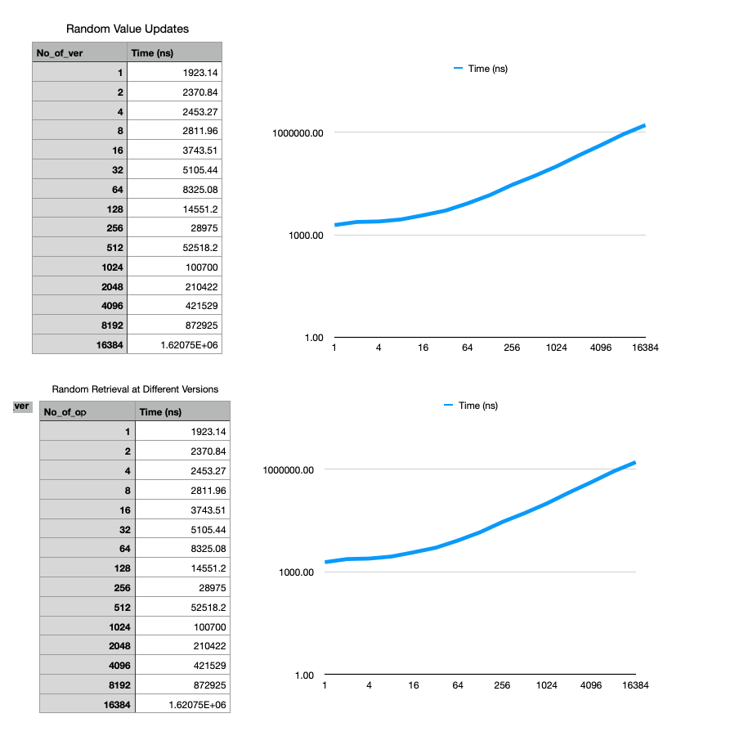
Average Time complexity (Using benchmarking tools)

Slide 33
Average Time Complexity (Modify)
For n number of iterations, the time required is proportional to n
So it can be concluded that average time complexity for single modification of a value at a certain position of persistent array ≈ O(1)

Slide 34
Average Time Complexity (Retrieve)
m = number of modification at the required node
V = number of versions created

